Slide 1
UE19CS390A – Project Phase – 1
End Semester Assessment
Project Title :Recipe Recommendation Based On Ingredients Recognition Using CV AND ML(RRIR)
Project ID :14
Project Guide :Prof Swati Pratap Jagdale
Project Team :A R Manyatha
Amulya Dinesh
Manasi Swain
Mihir Soni

Slide 2
Agenda
Introduction and Motivation
Problem Statement
Abstract and Scope
Literature Survey / Existing System
Suggestions from Review – 3
Requirements Specification
Design Approach
Design Constraints, Assumptions & Dependencies
Proposed System / Approach
Architecture
Design Description
Project Progress
References

Slide 3
Introduction and Motivation
Healthy eating is a important concern in ones life. So your run down to the cafeteria, may solve the food problem but eventually it takes its toll on your health, either through weight gain, lost energy, or both.
Our system will help overcome this issue, by providing simple recipes which can be made by using ingredients available in the pantry as home cooked meals are proven to be nutritious and healthy.

Slide 4
Problem Statement
The main objective of the proposed system is to assist users to decide what they can cook with the available resources. By pointing the camera at the food ingredients, users can immediately build a plan or have an idea of what they will be cooking, based on our recommendations along with the nutritional value of the recipe.
There are three main parts to this project: Computer vision to scan the ingredients; Machine learning to label the ingredients; to search the database for recipes from the dataset based on the ingredients, if the recipe is not present, perform web scraping.

Slide 5
Abstract and Scope
We will be creating a recipe recommendation system using pictures/videos of the pantry for a variety of uses. Camera will be used to scan the ingredients present in the pantry and provide the user with all the dishes and recipes possible. User has an option to specify the type of diet along with calorie range.

Slide 6
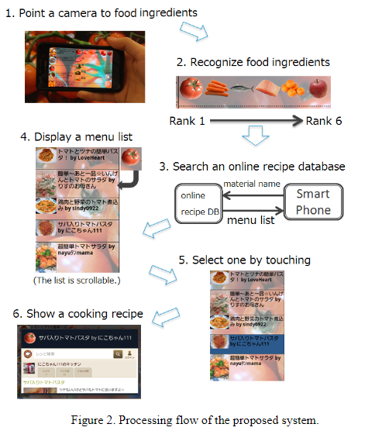
Literature Survey
Paper 1:
This approach proposed a cooking recipe recommendation system by employing object recognition for food ingredients such as vegetable and meat. By pointing mobile phone camera towards food ingredients, a user receives a recommendation list instantly.This system uses color-histogram and bag-of-features with SURF (Speeded Up Robust Features) extracted from multiple frames as an image representation and a linear kernel SVM as a classifier.
Image source

Slide 7
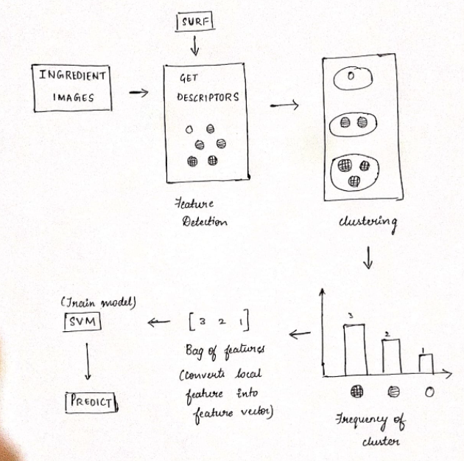
Literature Survey

Slide 8
Literature Survey
Is there a need for changing the approach?
Yes,
Improvement of the user interface and also considering the calorie count,nutrition of ingredients
Implement recipe search considering combination of multiple food ingredients
SURF algorithm has many disadvantages such as high dimension of feature descriptor, large amount of computation, and low matching accuracy

Slide 9
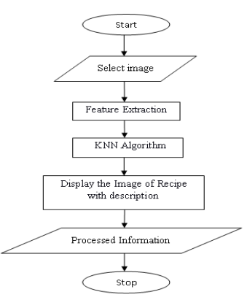
Literature Survey
Paper 2:
This approach proposes a cooking Recipe Retrieval System. The system proposed, does the real time
recognition of the ingredient by name or image. It helps a user to retrieve set of recipes including those food
ingredients. This system also provides the facility for the user to view the images of ingredients. The system is developed using MATLAB. Harris Corner Detector, K-Nearest Neighbor technique and Scale Invariant Feature Transformer (SIFT) are used to build this system.
Image Source

Slide 10
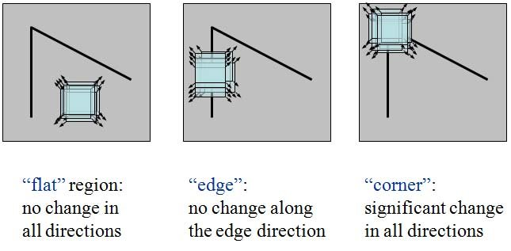
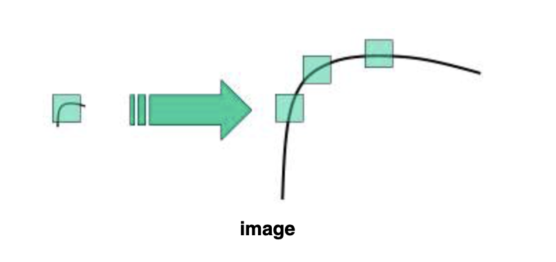
Literature Survey
Harris Corner Detector Scale Invariant Feature Transformer (SIFT)

Slide 11
Literature Survey
Is there a need for changing the approach?
Yes,
The implementation uses web application, which is not necessarily user friendly (compared to mobile app)
The ingredients must be selected from a drop down list and object detention is not done using camera.
KNN does not work well with large dataset as calculating distances between each data instance would be very costly.

Slide 12
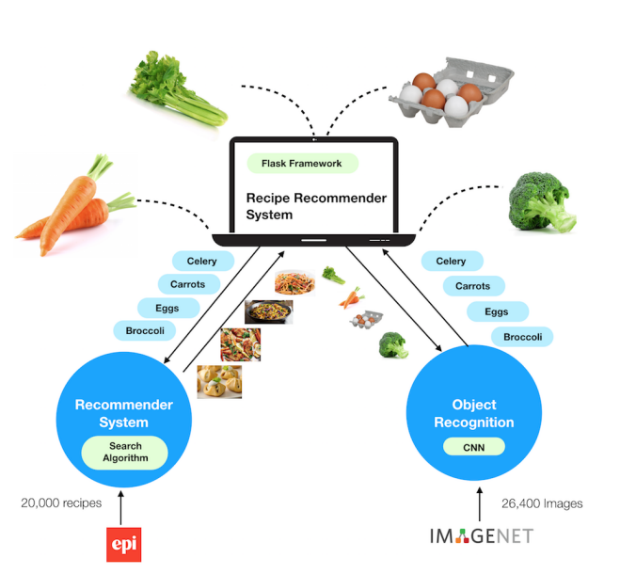
Literature Survey
Paper 3:
This approach proposes a recipe recommendation system employing image recognition of food ingredients, specifically vegetables. The system is a web application that performs image recognition on the uploaded images and recommends recipes that contains the recognized ingredients. It has a convolutional neural network (CNN) model
for image recognition to identify five categories of food ingredients.
Image Source

Slide 13
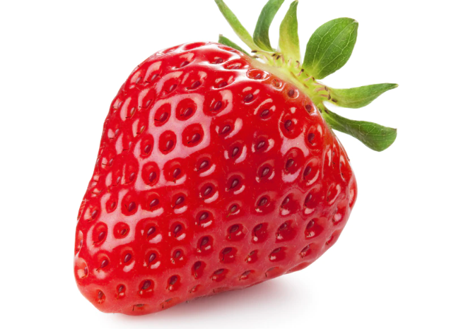
Literature Survey
Is there a need for changing the approach?
Yes,
Diet and nutrition constraints are not considered
CNN is single labeled, each picture will have only one ingredient
The user is not given an option to upload video.
Single labeled CNN
Strawberry

Slide 14
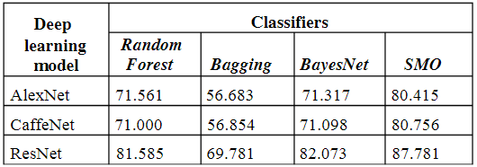
Literature Survey
Paper 4:
Description of the approaches used: First, an overview of the state-of-the-art research in food detection and CNNs is provided in section. Presents the details of the proposed multi-class food classification. Analyzes the experimental results on three different CNN models.

Slide 15
Literature Survey
Is there a need for changing the approach?
Yes,
Diet and nutrition constraints are not considered
The user is not given an option to upload video.
Large dataset is not used in this approach

Slide 16
Suggestions from Review - 3
Detail architecture diagram
Researach on multi-label CNN classifier

Slide 17
Design Constraints, Assumptions & Dependencies
Android device - The device should be of newer compatible versions with a good working camera and should have enough storage space to accommodate our app.
End-user environment- The model requires a server with high speed internet capability. The end user should be equipped with fair network bandwidth to send images and receive recipes.

Slide 18
Design Details
Novelty
Our project not only focuses on recommending a recipe list, but also, caters to the needs of the user by considering diet choice and calorie range. As far as our literature survey is concerned, we haven't come across any project which considered the type of diet along with calorie count. This will be inculcated into our project to make it more practical for everyday use.
Reliability
The model requires a server with high speed internet capability. The user should be equipped with fair network bandwidth to send images and receive recipes

Slide 19
Design Details
Performance
Availability: The server should be available on specified time as many users are waiting for the recipe to be generated .
Correctness: Accurate recipes should be recommended to the user in real time.
Usability: The model should handle multiple requests from multiple users.
Reusability
Object detection is the first phase of our project that can be reused. On training the model on different datasets, it can be able to identify different kinds of objects other than food ingredients. Hence, object detection algorithm can be reused.

Slide 20
Design Details
Security
Authentication of user whenever he/she logs into the system. The users will have private user profiles which will store user information.We will have a user-id and a password for authentication which will be logged in in the mobile application.
Maintainability
The administrators should ensure that the server is up and running and not overloaded, ensuring it is well maintained.

Slide 21
Proposed Methodology / Approach
Basic Approach and results obtained
Recipe recommendation system by employing object recognition for food ingredients such as vegetable, fruits and meat. By pointing mobile phone camera towards food ingredients, a user receives a recommendation list.
Proposed models:
OpenCV: extract video frames and saves images using Python
CNN: 1. Feature Extraction
2. Multi-label Image Classification

Slide 22
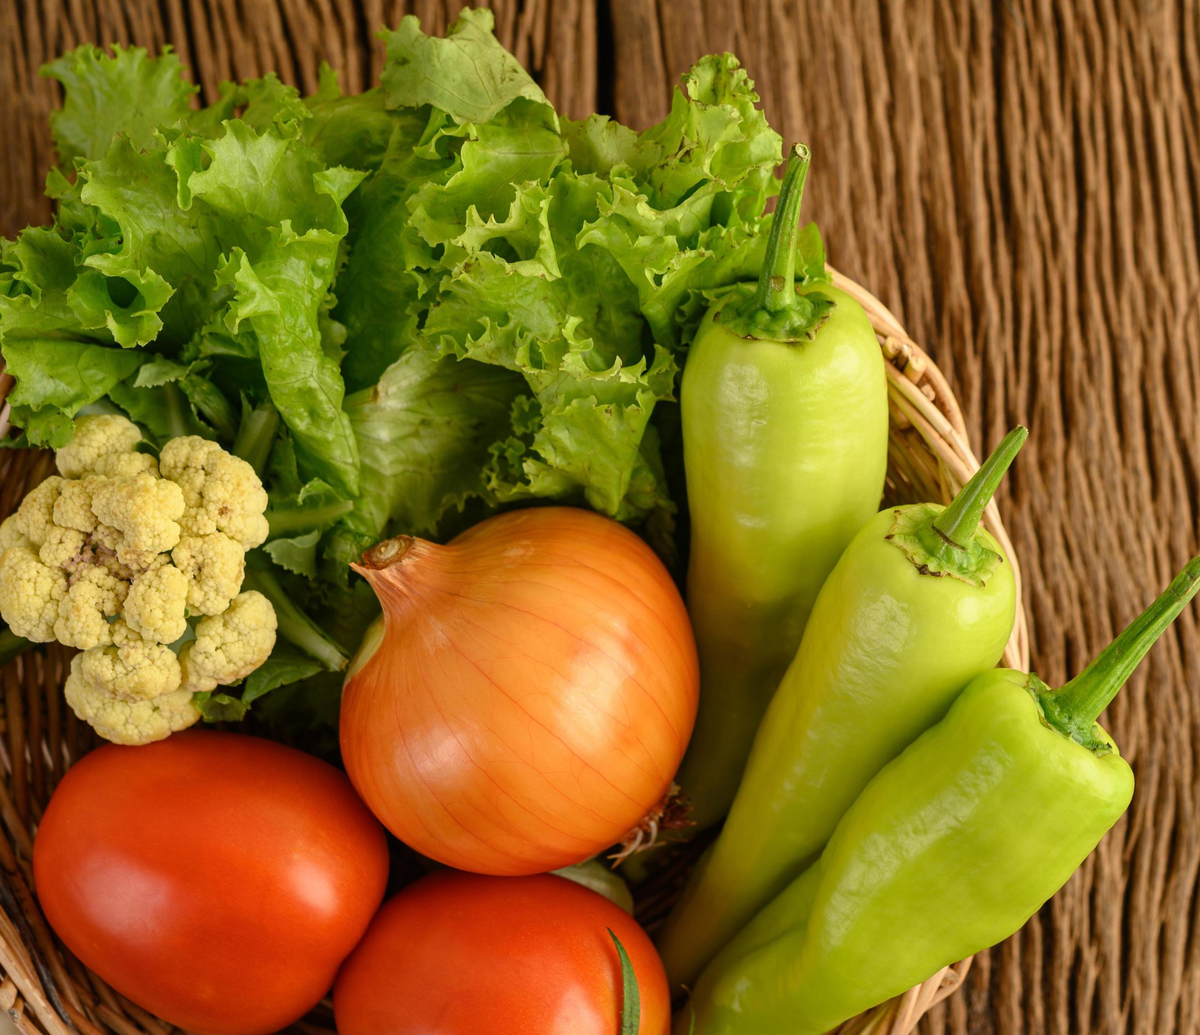
Proposed Methodology / Approach
Lettuce
Chilli
Multi-label Image Classification using CNN
Onion
Tomato
Cauliflower

Slide 23
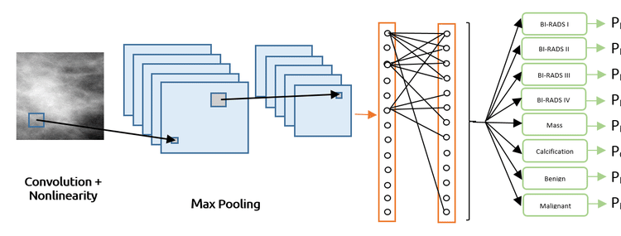
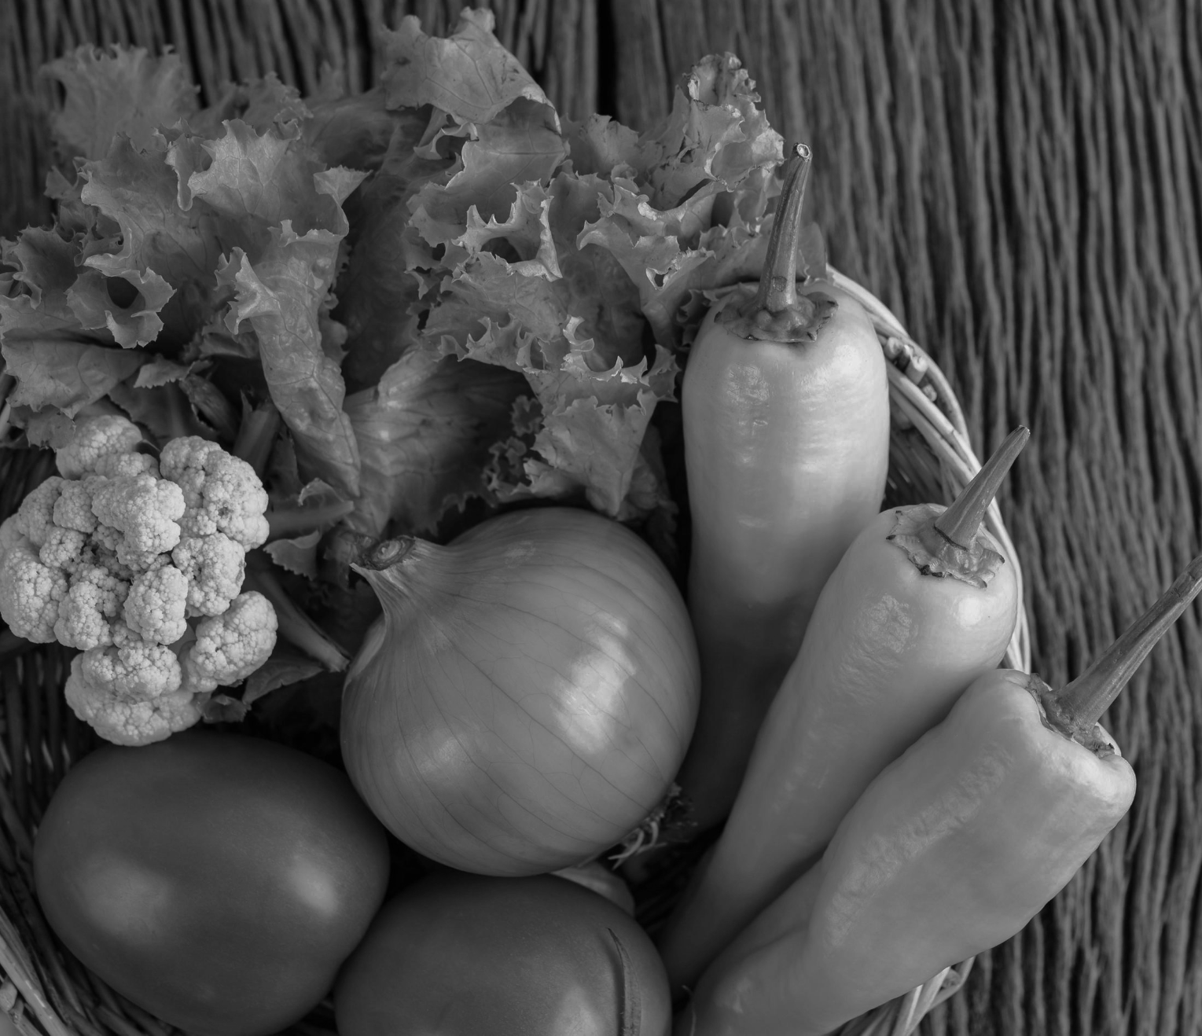
Proposed Methodology / Approach
Orange
Apple
Beans
Carrot
Capsicum
Mango
Papaya
Brinjal
Fully connected layer
Multi-label Image Classification using CNN

Slide 24
Proposed Methodology / Approach
2. Is there a need for changing the approach?
No, there is no need for change in the proposed approach as of now. As per our literature survey, these models are best suited for our project and yields good results.
We may have to change it in the future if we experience any unforeseen situations.

Slide 25
Proposed Methodology / Approach
3. Details of the new approach- benefits/drawbacks
Benefits: Variety of recipe lists which match the user requirements are recommended. Large number of ingredients are considered while training the model.
Drawbacks: Huge dataset might lead to more processing time and resource consumption.

Slide 26
Architecture
Choice of Architecture considered : Layered (n-tier) architecture
This architecture can be used to structure programs that can be decomposed into groups of subtasks, each of which is at a particular level of abstraction. Each layer provides services to the next higher layer.

Slide 27
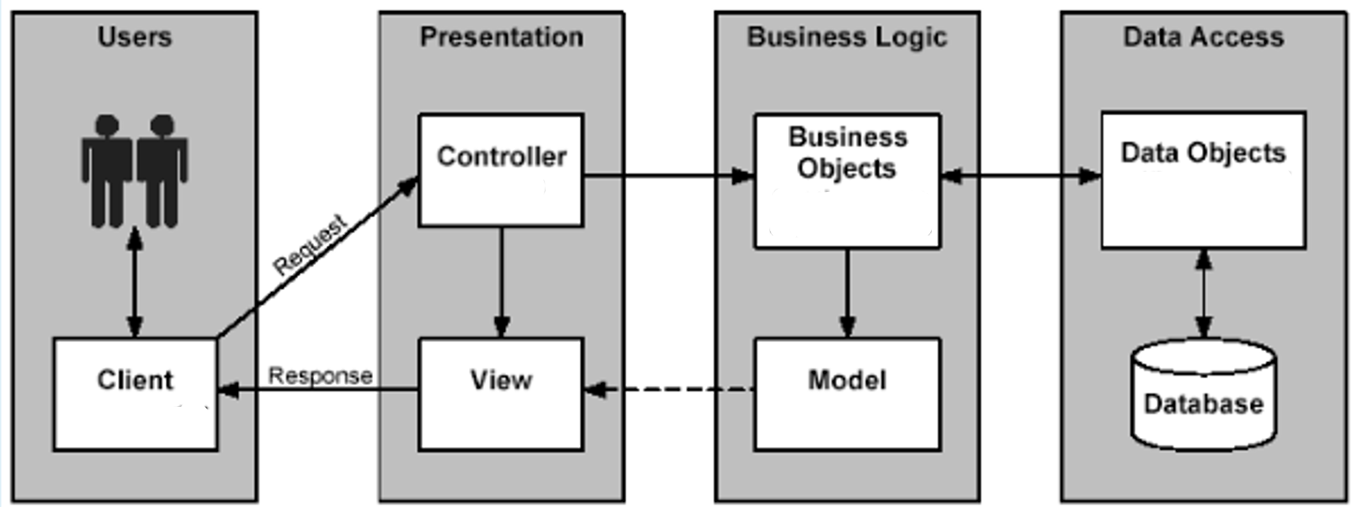
Architecture

Slide 28
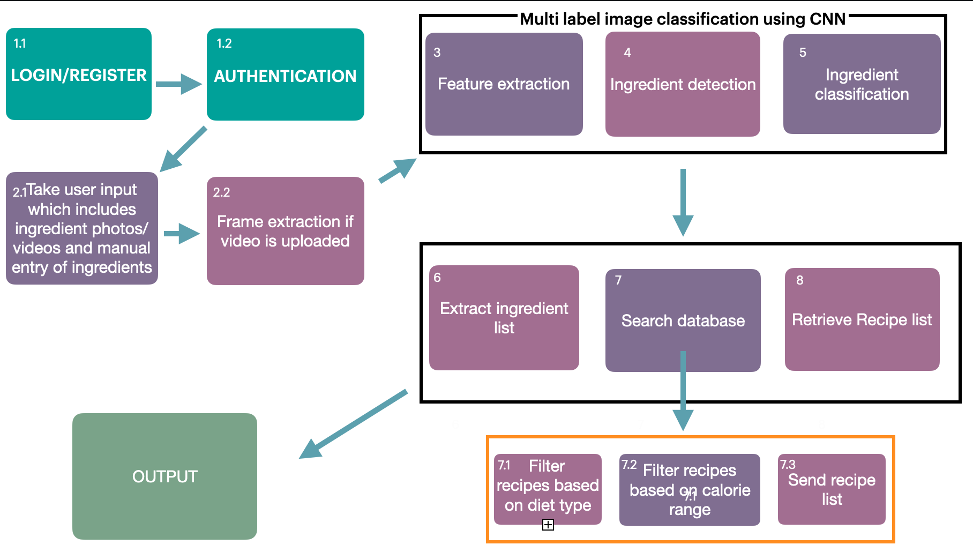
Architecture

Slide 29
Design Description (if applicable)
Master class diagram
ER Diagram
User Interface Diagrams/ Use Case Diagrams
External Interfaces
Deployment Diagram

Slide 30
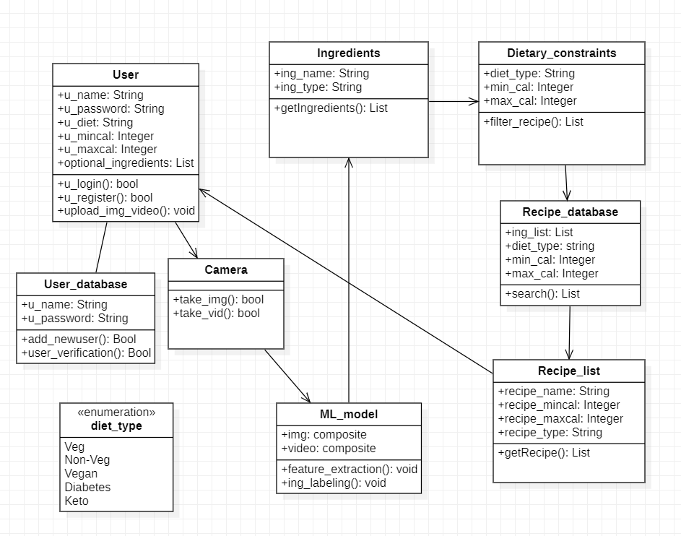
MASTER CLASS DIAGRAM

Slide 31
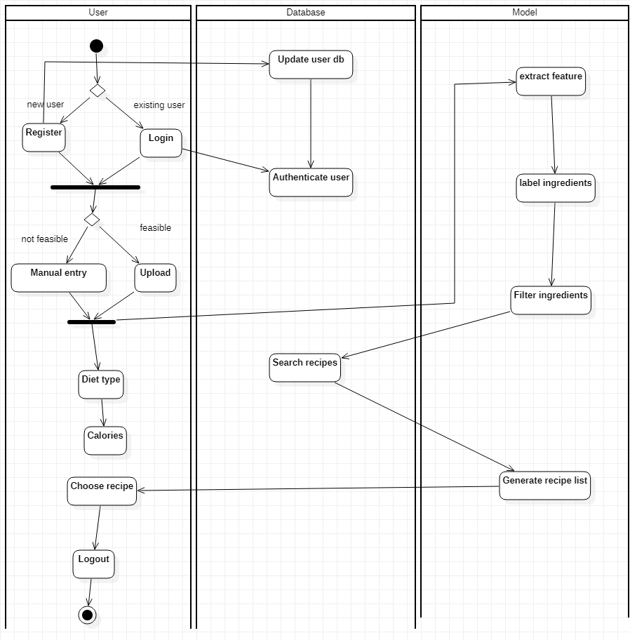
SWIMLANE DIAGRAM

Slide 32
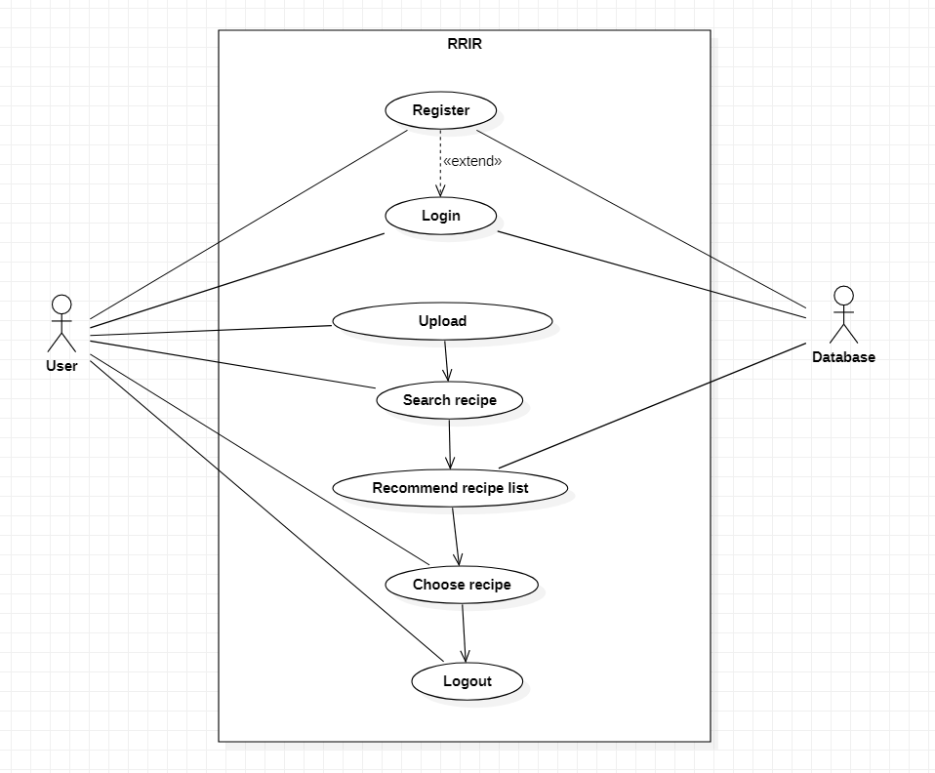
USE CASE DIAGRAM-1

Slide 33
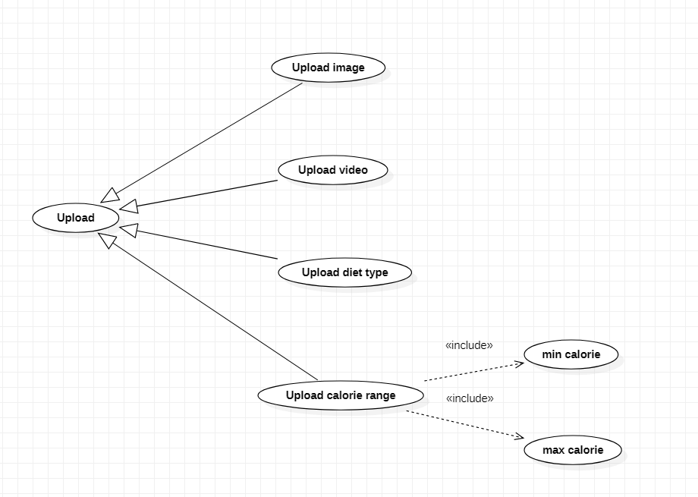
USE CASE DIAGRAM-2

Slide 34
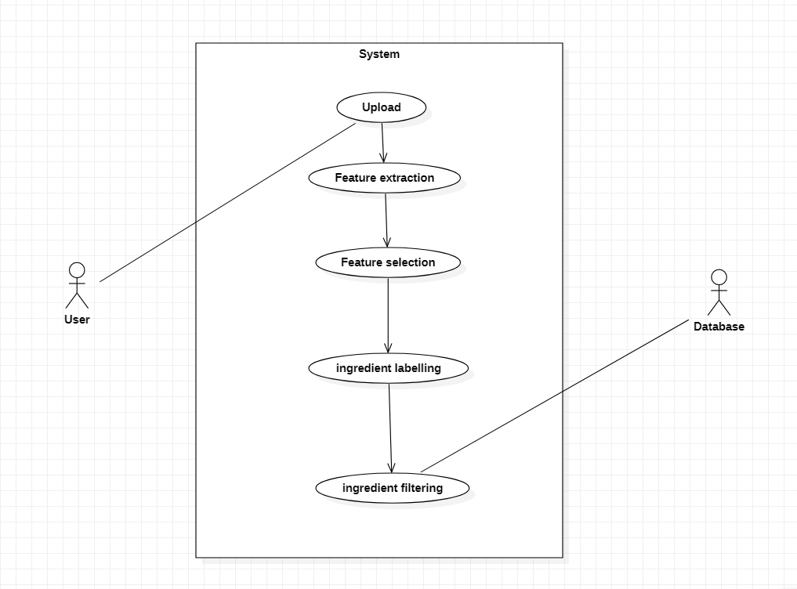
USE CASE DIAGRAM-3

Slide 35
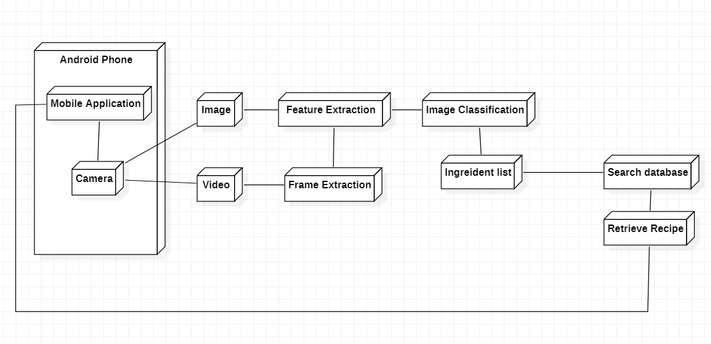
DEPLOYMENT DIAGRAM

Slide 36
Project Progress
Literature survey pertaining to various models and approaches studied and analysed so far.
Understanding the user environment to design a compatible user interface.
Finalising on the best working models for the functionalities to perform their best.
Finalising the datasets that will be used for the system.

Slide 37
Capstone (Phase-I & Phase-II) Project Timeline
Provide
The timelines for execution of the project through Gantt chart.
The plan in terms of efforts by individuals in the team.
Mention the tasks involved in different stages.

Slide 38
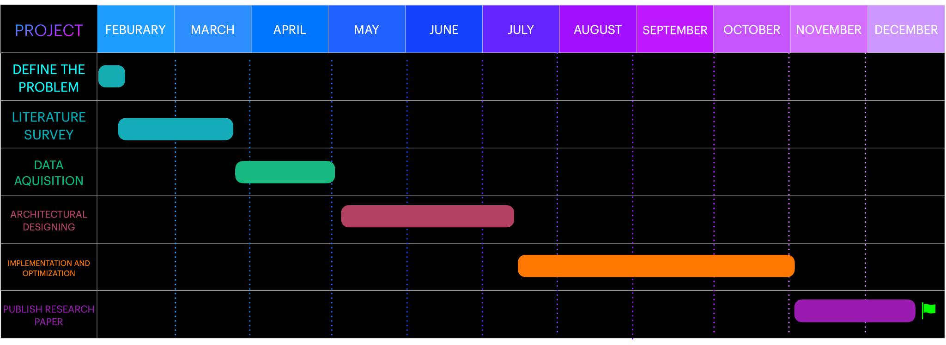
Capstone (Phase-I & Phase-II) Project Timeline
GANTT CHART

Slide 39
Capstone (Phase-I & Phase-II) Project Timeline
The plan in terms of efforts by individuals in the team:
Everyone will participate in pair programming
Everyone will be doing their individual research and will be briefing everyone about it.

Slide 40
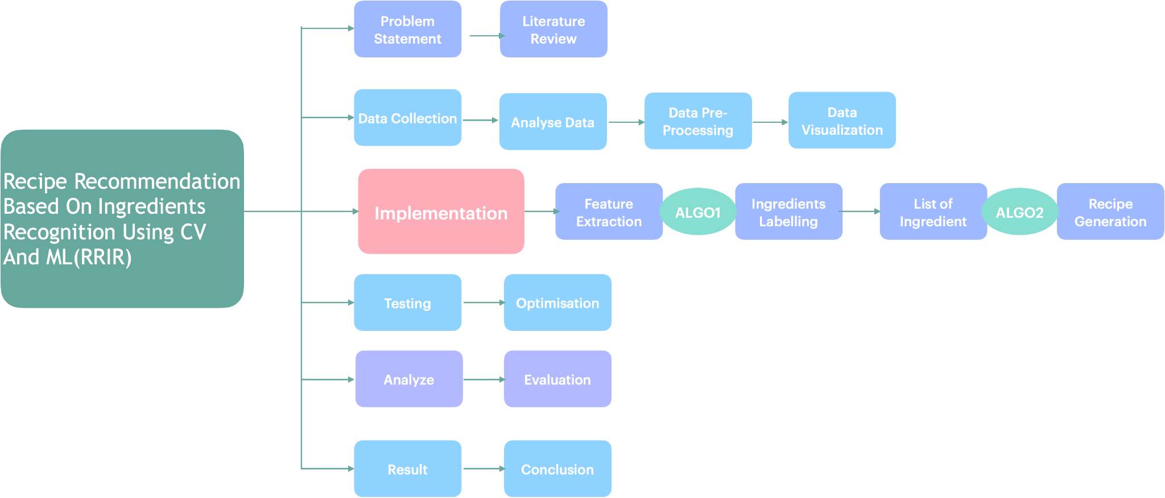
Capstone (Phase-I & Phase-II) Project Timeline

Slide 41
Conclusion
Computer Vision - Object detection is a computer vision technique that allows us to identify and locate objects in an image or video. Here, we use a camera to scan the ingredients present in the pantry.
Machine Learning - In machine learning, data labeling is the process of identifying raw data and adding one or more meaningful labels to provide context so that a machine learning model can learn from it. The ingredients scanned by using CV are now labeled using ML models for accurate results .

Slide 42
Conclusion
Search / Web Scraping - The recipe for the list of labeled ingredients obtained from the above steps is searched from the predefined database. If the ingredients do not match with the existing data, web scraping is performed. The list of recipes which meet the requirements are returned to the user, to choose from.
Mobile Application - A simple UI will be created where the user can login and create an account. Once logged in, the user can upload the images of ingredients. These images are processed and the list of suitable recipes are recommended. Additionally, the calories of each recipe will be displayed.

Slide 43
References
Keiji Yanai, Takuma Maruyama, Yoshiyuki Kawano, “A Cooking Recipe Recommendation System with Visual Recognition of Food Ingredients”, 2014
Gangothri R. Sanil , Anusha Anchan , Vijetha Achar, Kavya Hegde, “KNN based Recipe Retrieval using Ingredient Recognition”, 2018
https://medium.com/@akhiljanardhanan525/multi-label-image-classification-using-cnn-python-9c5dbddf7dc7
https://medium.com/nanonets/how-to-easily-classify-food-using-deep-learning-and-tensorflow-cbe9b1dc302c

Slide 44
Thank You

